Slide 1

Elements of Electrical and Electronics Engineering (7AC48) UNIT-II: Fundamentals of AC Circuits
By
Dr. G. Ramesh (Mob:9182516594)
Associate Professor, Dept. of EEE

Slide 2
Unit-II: Syllabus
AC voltage wave form and basic definitions,
‘j’operator
Analysis of single phase AC circuits series and parallel (simple circuits)
Analysis of three phase AC circuits
Star-Delta Connections
Relation between line and phase voltages/currents in a three phase star-delta balanced system.

Slide 3
AC voltage wave form
Alternating voltages and currents are represented by a sinusoidal wave or simply a sinusoid.
Among all the waveforms (pulse, saw-tooth and square etc) , sine waves are frequently used because of their ease of representation and some specific advantageous characteristics.
The sine or sinusoidal wave is a curve that describes a smooth repetitive oscillation.
We can define the sine wave as “The wave form in which the amplitude is always proportional to sine of its displacement angle at every point of time” with change in polarity and direction.

Slide 4
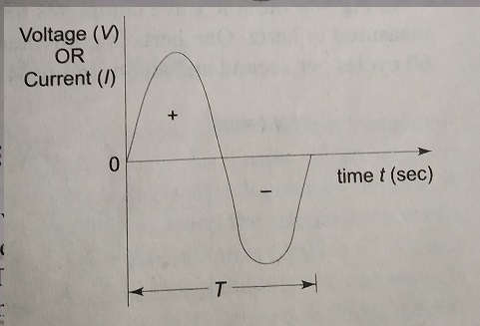
The shape of the sine wave is shown in figure
The wave form may be current or voltage, it changes its magnitude and direction with time.

Slide 5
If it start at t=0, the wave goes to maximum value and returns to zero and decreases to negative maximum value before returning to zero.
The sine wave changes in orderly manner. During the positive portion of voltage, the current flows one direction and during the negative portion of voltage current flows in the opposite direction.
Complete positive and negative portion of the wave is one cycle of the sine wave.
The time taken for any wave to complete one full cycle is called the time period (T). The period can be measured in following different ways.

Slide 6
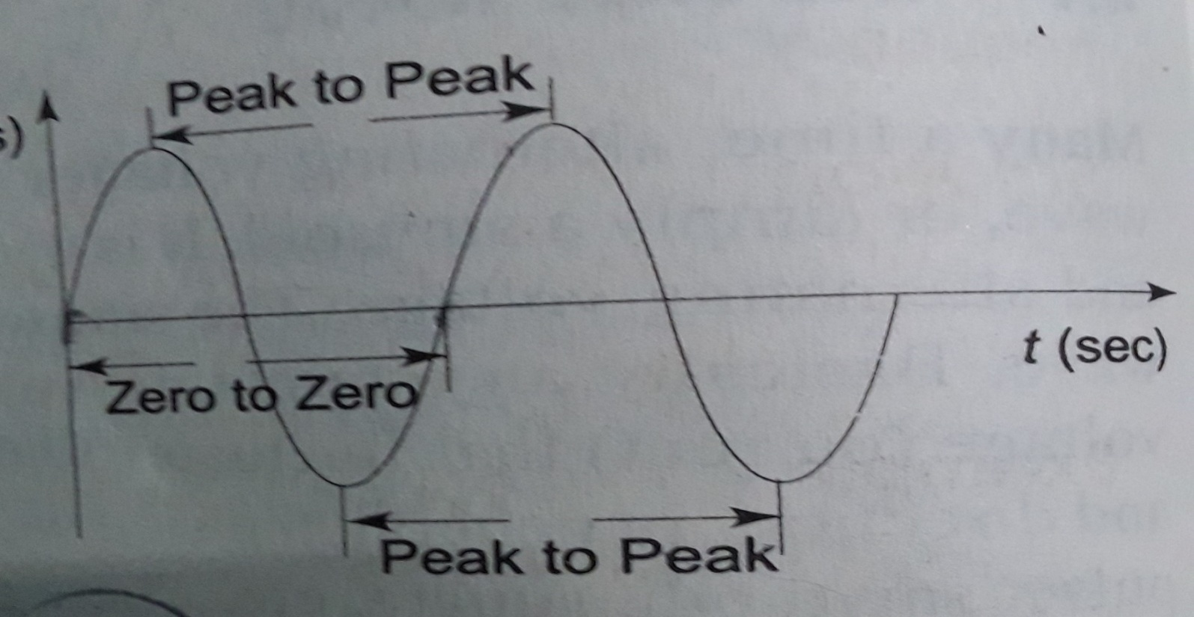
i. From zero crossing of one cycle to zero crossing of next cycle.
ii. From positive peak of one cycle to positive peak of next cycle.
From negative peak of one cycle to negative peak of next cycle.

Slide 7
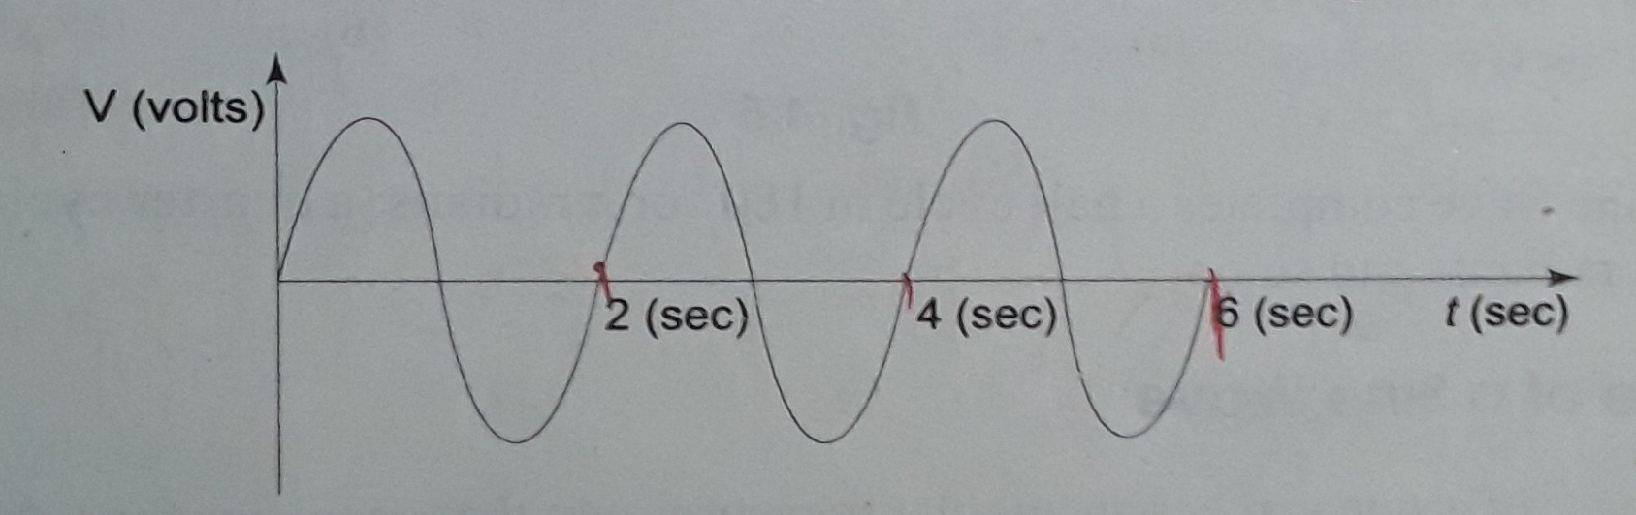
The frequency of a wave is defined as the number of cycles that a sine wave completes in one second. The frequency (f) measured in hertz (Hz), one hertz is equivalent to one cycle per second, 50Hz means 50 cycle per second.
The relation between time period and frequency is given by
What is the time period of sine wave shown in figure

Slide 8
Voltage and Current Values of a Sine Wave
As the magnitude of the waveform is not constant, the wave form can be measured in different ways. These are instantaneous, peak, average and rms values
(I). Instantaneous Value
The instantaneous value is “the value of an alternating quantity (it may ac voltage or ac current or ac power) at a particular instant of time in the cycle”. There are uncountable number of instantaneous values that exist in a cycle.
This value is different at different points along with wave form. During the positive cycle, the instantaneous values are positive and during negative cycle its are negative.

Slide 9
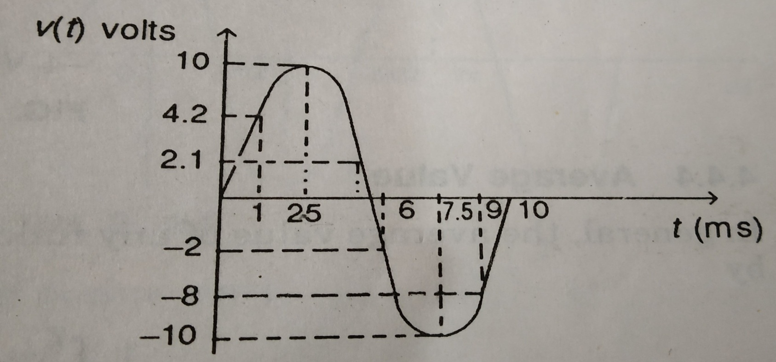
The above figure shown at time 1 ms, the instantaneous value is 4.2 V; the value is 10 V at 2.5ms, -2 V at 6ms and -10 V at 7.5 ms and so on.
At any given time, the voltage or current has some instantaneous values.

Slide 10
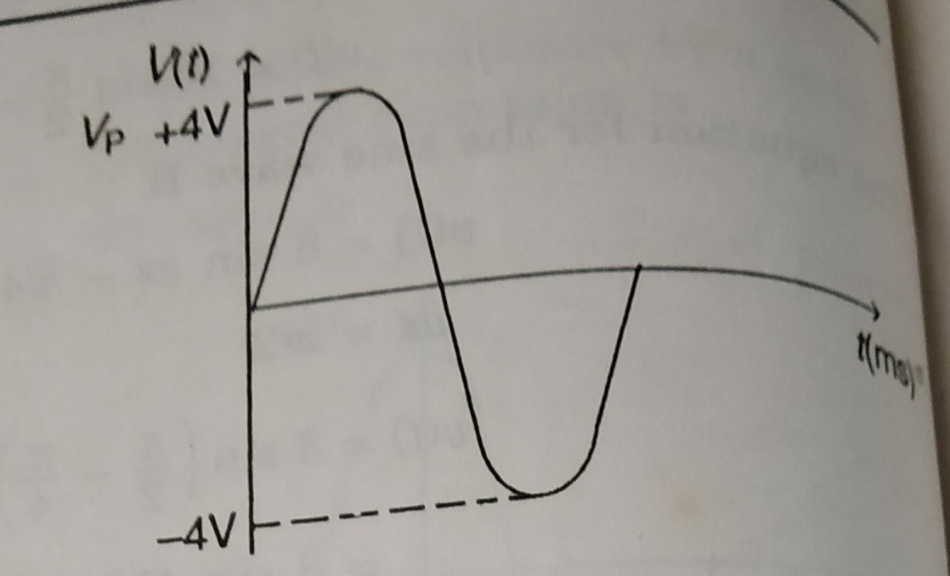
(II). Peak Value
The peak value of the sine wave is the maximum value of the wave during the positive half cycle or maximum value of wave during the negative half cycle.
The peak value of the sine wave is shown in the figure is 4V.

Slide 11
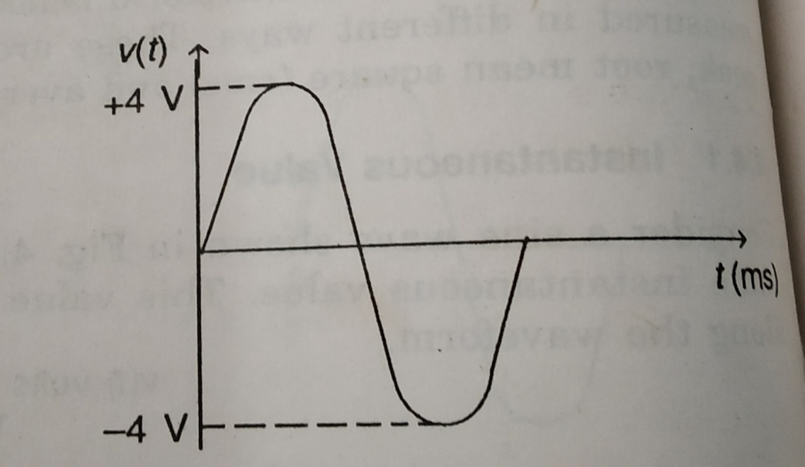
(III). Peak to Peak Value
The peak to peak value of a sine wave is the value from the positive to negative peak.
The peak to peak value of the sine wave is shown in the figure is 8V.

Slide 12
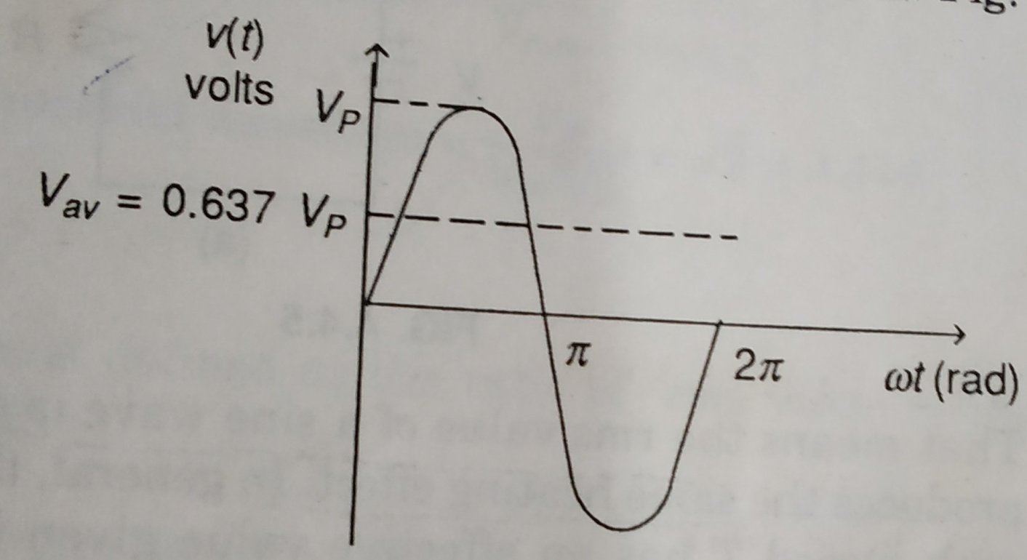
(IV). Average Value
The average value of the sine wave is the total area under the half cycle curve divided by the distance of the curve.
The average value of the sine wave is

Slide 13
(V). Root Mean Square (rms) Value
The rms value of a sine wave is a measure of the heating effect of the wave.
Whenever a resistor is connected across a dc voltage source, a certain amount of heat is produced in the resistor in a given time.
By using same resistor and same time, apply ac supply to circuit and produced same heat. That means the rms value of a sine wave is equal to the dc voltage that produces the same heat effect.
The rms value of the sine wave is

Slide 14
(VI). Peak Factor (PF)
The peak factor of any wave form is defined as the ratio of the peak value of the wave to rms value of the wave.
The peak factor of the sinusoidal waveform is

Slide 15
(VII). Form Factor (FF)
The form factor of any wave form is defined as the ratio of the rms value to average value of the wave.
The form factor (FF) of the sinusoidal waveform is

Slide 16
Problem 1: A sine wave has a peak value of 25 V. Determine the following values (i) rms (ii) Peak to peak (iii) Average (iv) Form factor and (v) Peak factor.
Advantages of AC system over DC system
1. AC voltages can be efficiently stepped up/down using transformer.
2. AC motors are cheaper and simpler in construction than DC motors.
3. Switchgear for AC system is simpler than DC system.

Slide 17
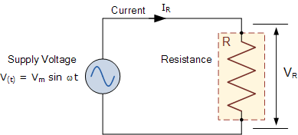
Single Phase AC circuits
In electrical engineering, single-phase electric power is the distribution of alternating current electric power using a system in which all the voltages of the supply vary in unison.
1. Phase Relation in Pure Resistor
when a sinusoidal voltage of certain magnitude is applied to a resistor, certain amount of sine wave current passes through it.

Slide 18
The relation between v(t) and i(t) in case of resistor is linear.
The alternating voltage is given by
(1)
The current flowing in the circuit is by using ohms law
(2)
where

Slide 19
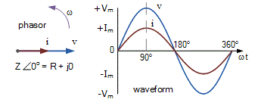
From equation (1) and (2) we conclude that in a pure resistive circuit, the voltage and current are in phase. Hence the voltage and current waveforms and phasors can be drawn as below.
With ac voltage applied to elements, the ratio of exponential voltage to current is called impedance, it has magnitude and phase angle. The impedance in case of resistor consists only of magnitude, the phase angle is zero.

Slide 20
Problem 2: A sinusoidal voltage (230V, 50Hz) is applied to the 10 ohm resistive circuit. Determine the following values
Current, ii) , iii) , iv) , v)
vi) power consumed by resistor and vii) equation for voltage and current.

Slide 21
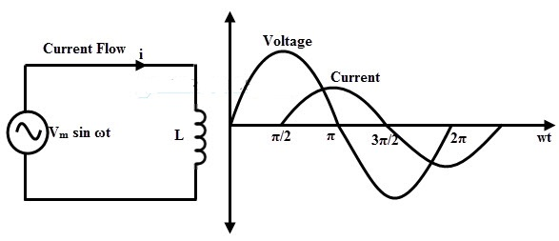
2. Phase Relation in Pure Inductor
In pure inductor, the voltage and current out of phase. The currents lags behind the voltage by 90 digress. The voltage current relation of in case of inductor is given by
(1)

Slide 22
Substitute in equation (1) and get
The impedance which is the ratio of exponential voltage to corresponding current is given by
(2)
From equation (1) substitute current value and get , substitute this value in equation (2) and get impedance (3)
Where and is called inductive reactance.

Slide 23
Problem 3: A pure inductive coil allows a current of 10A to flow from a 230V, 50 Hz supply. Find (i) impedance of the circuit (ii) inductance of the coil and (iii) instantaneous equations for voltage and current.

Slide 24
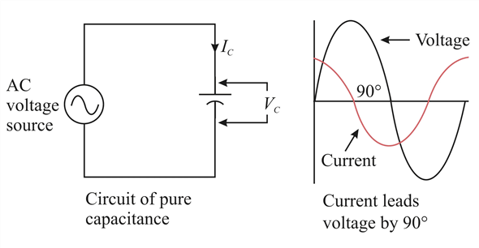
3. Phase Relation in Pure Capacitor
In pure capacitor, the voltage and current out of phase. The voltage lags behind the current by 90 digress. The voltage current relation of in case of capacitor is given by
(1)

Slide 25
Substitute in equation (1) and get
The impedance which is the ratio of exponential voltage to corresponding current is given by
(2)
From equation (1) substitute current value and get substitute this value in equation (2) and get impedance (3), where and is called capacitive reactance.

Slide 26
Problem 4: A 318μF capacitor is connected across a 200V, 50 Hz system. Find (i) the capacitive reactance (ii) current and (iii) equations for instantaneous voltage and current.

Slide 27
Single phase Series circuits
In series and parallel circuits impedance is a complex quantity having real and imaginary parts.
Where the real part is the resistance and imaginary part is the reactance of the circuit.
The series circuits are classified into three types
RL series circuit
RC series circuits
RLC series circuits

Slide 28
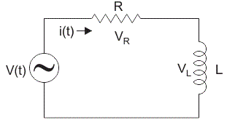
i. RL Series Circuit
If sinusoidal input is applied to RL circuit, the current in the circuit and voltage across all the elements are sinusoidal.
In this analysis, find impedance, current, phase angle and voltage drops.
In series RL circuit, the source voltage is phasor sum of
and ,

Slide 29
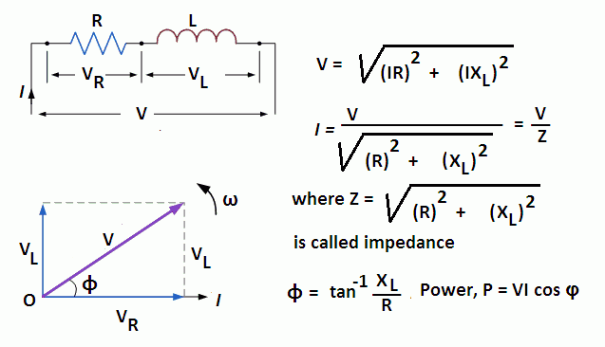
The angle between inductance and resistance is the phase angle between the current and voltage applied to the circuit.

Slide 30
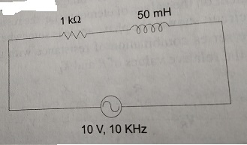
Problem 5: the figure consisting a 1 KΩ resistor connected in series with 50 mH coil, a 10 V, 10 KHz signal is applied. Find impedance, current, voltage across resistance and inductance.

Slide 31
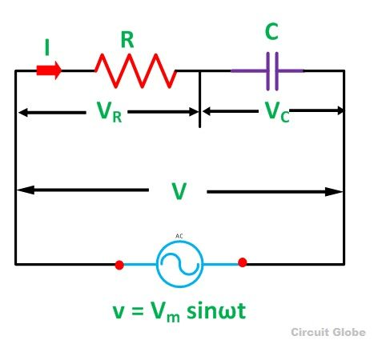
ii. RC Series Circuit
In RC circuit, the capacitance is connected in series with resistance. Find impedance, current, phase angle and voltage drops.
In series RC circuit, the source voltage is phasor sum of and ,

Slide 32
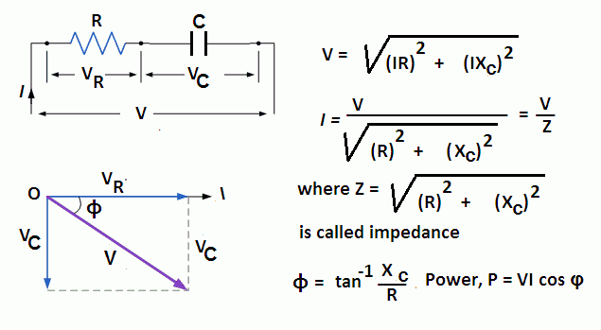
The angle between capacitance and resistance is the phase angle between the current and voltage applied to the circuit.

Slide 33
Problem 6: A sine wave generator supplies a 50Hz, 50 V signal to a 100Ω resistor series with 10µF capacitor. Determine the total impedance, Current, Phase angle, and voltage across each elements.

Slide 34
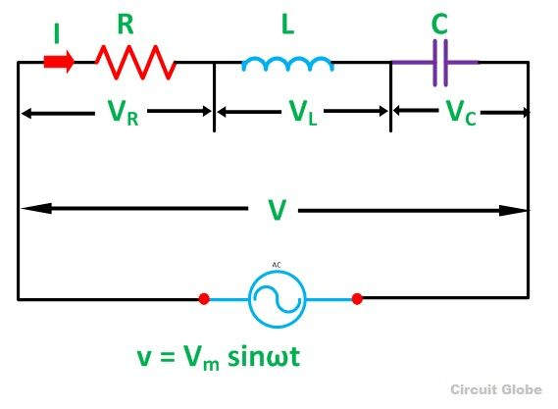
iii. RLC Series Circuit
In series RC circuit, the source voltage is phasor sum of
and ,

Slide 35
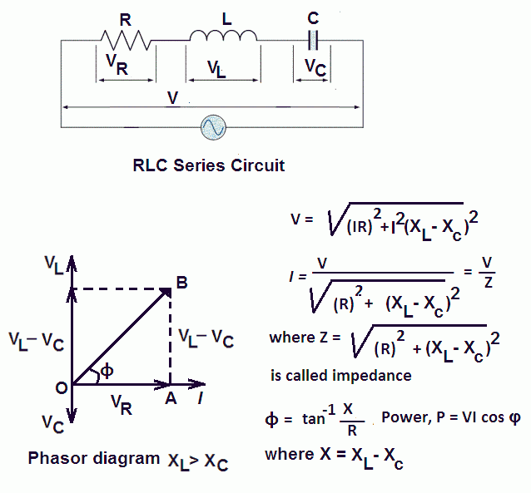
The angle between reactance and resistance is the phase angle between the current and voltage applied to the circuit.

Slide 36
Problem 7: A sine wave generator supplies a 50Hz, 20 V signal to a 200Ω resistor in series with 50mH inductor & 318µF capacitor. Determine the total impedance, Current, Phase angle, voltage across each elements.

Slide 37
Single phase parallel circuits
In series circuits, the current is the same in all the parts of the circuit. In parallel ac circuits, the voltage is same across the each element of the circuit.
Where the resistive voltage is real part of the complex voltage and capacitive voltage is the imaginary part.
The parallel circuits are classified into three types
RL parallel circuit
RC parallel circuits
Compound circuit (series-parallel) circuits

Slide 38
RL parallel circuit:
Current in the resistive branch
Current in the inductive branch
Total current in RL parallel circuit is
Impedance of the circuit

Slide 39
RC parallel circuit:
Current in the resistive branch
Current in the inductive branch
Total current in RC parallel circuit is
Impedance of the circuit

Slide 40
RLC parallel circuit:
Current in the resistive branch
Current in the inductive and capacitive branch
Total current in RL parallel circuit is
Impedance of the circuit

Slide 41
Three Phase Circuits
There are two types of system available in electric circuit, single phase and three phase system.
In single phase circuit, there will be only one phase, i.e the current will flow through only one wire and there will be one return path called neutral line to complete the circuit.
Three phase circuit is the poly-phase system where three phases are send together from the generator to the load.
Each phase are having a phase difference of 120º, i.e 120º angle electrically.

Slide 42
Advantages:
The power generated by the same machine increases 41 percent from single phase to two-phase, and the increase in the power is 50 percent from single phase to three phase, beyond three phase maximum increase is 5 percent.
Three phase system has balanced system, three phase motors are more easily started than single phase motors. Single phase motors are not self starting, where as three phase motors are self starting.
All three phase machines are superior in performance. Their control equipments are smaller, cheaper, lighter in weight and more efficient.

Slide 43
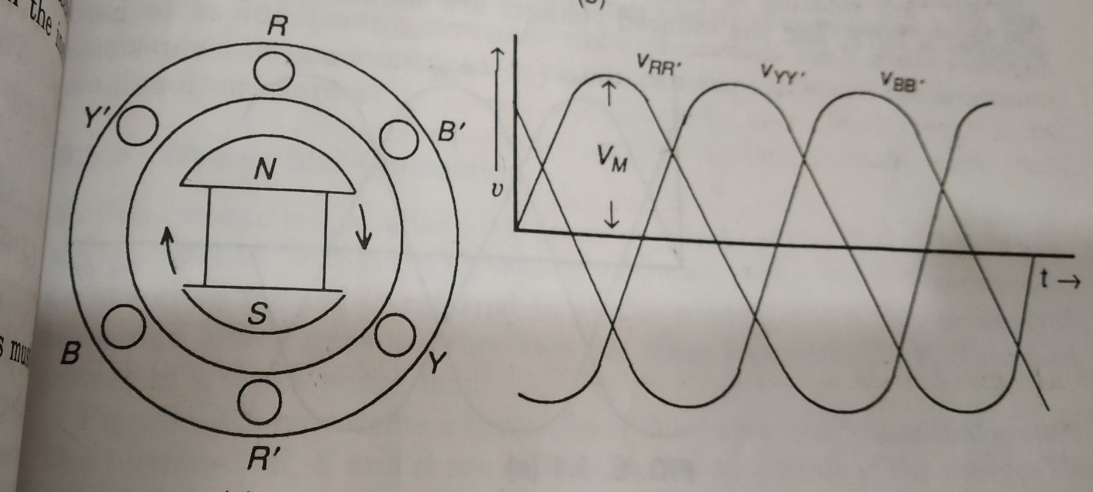
Generation of three phase voltages
Three phase voltages can be generated in a stationary armature with rotating filed structure.

Slide 44
Here constitute one coil (R-Phase); another coil (Y-Phase) and constitutes the third phase (B-Phase). The field magnets are assumed in clockwise rotation.
The voltage generated by a three-phase alternator is shown in above figure. The three voltages are same magnitude and frequency, but they are displaced by 120 degrees.
The three phase instantaneous voltage equations can be written as

Slide 45
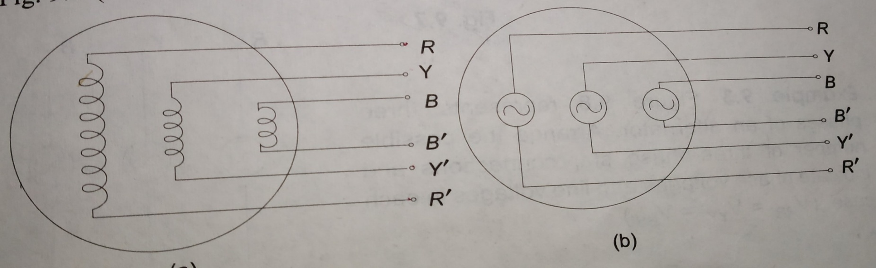
Inter connection of three phase source/load
In a three phase alternator, there are three independent phase windings or coils. Each phase or coils has two terminals (starts and finish).
The end connections of the three sets of the coils may be brought out of the machines to connect Star (Y) or Delta( ) windings.

Slide 46
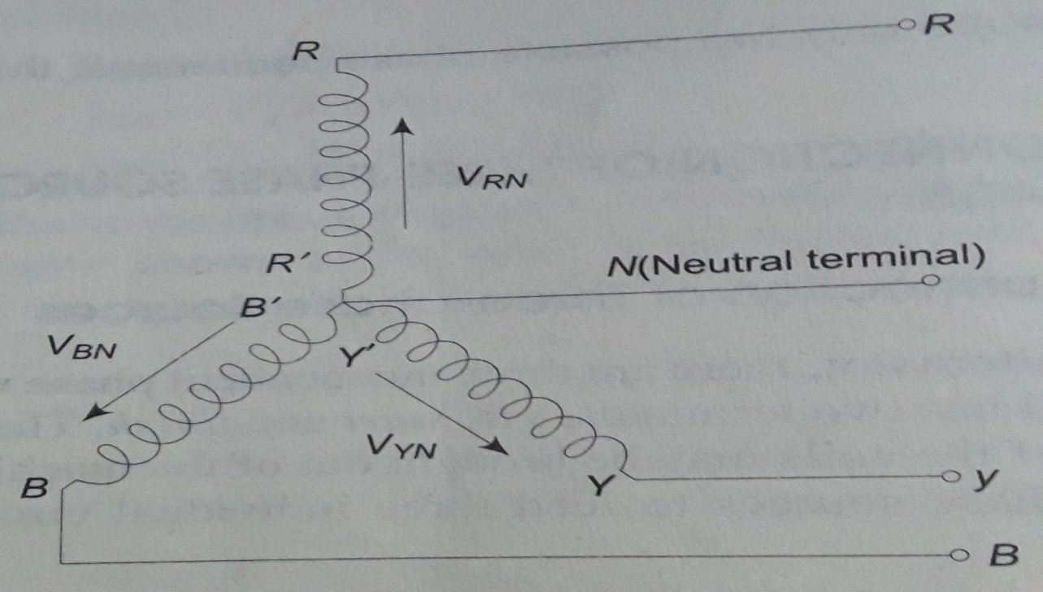
Star (Y) connection
In this connection, similar ends (start or finish) of three phase joined together formed as the neutral point (N). Three lines are run from the other free ends (R,Y,B) to feed power to the three phase load.

Slide 47
The above figure, represents a three-phase four wire star connected system. The terminals R,Y and B are called the line terminals of the source.
The voltage between any line and the neutral point is called phase voltage , while the voltage between any two lines is called the line voltages
The current flowing through the phases are called phase currents, while those flowing in the lines are called line currents.
The system so formed will supply equal line voltages displaced 120 degrees from one another.

Slide 48
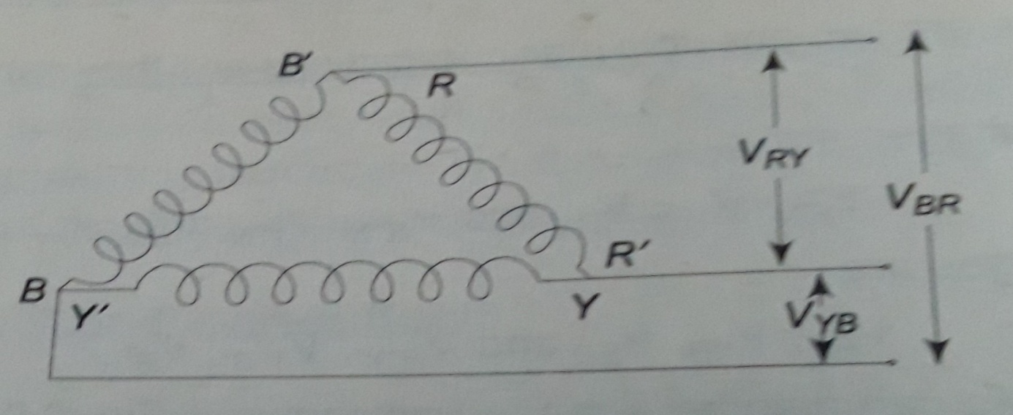
Delta ( ) connection
In this connection, the dissimilar ends of the windings are joined together, i.e. is connected to , to and to .
Here there is no common terminal, only three line voltages are available . This line voltage also referred as phase voltages in delta connected system.

Slide 49
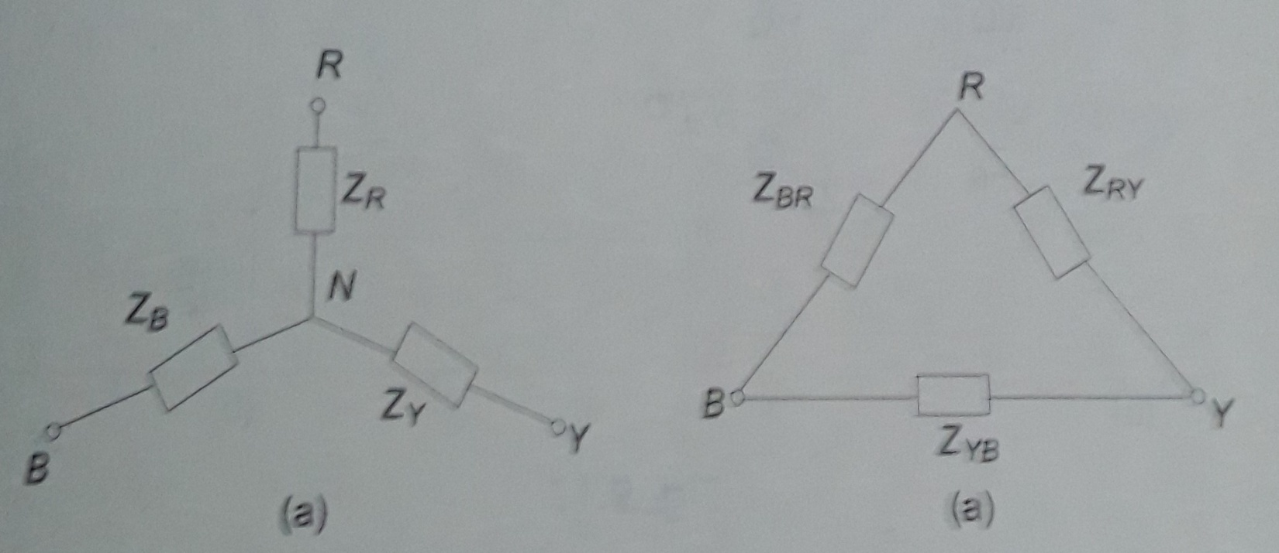
Star to Delta and Delta to Star Transformation
While dealing with currents and voltages in loads, it is often necessary to convert a star load to delta load, and vice-versa.
Where the delta connection of resistances/impedances are replaced by star connection of resistances/impedances vice-versa depends on circuit requirements.

Slide 50
Use above Fig, convert Star to Delta:
Delta impedance in terms of star impedances are given

Slide 51
Use above Fig, convert Delta to Star:
Star impedance in terms of Delta impedances are given

Slide 52
Problem 8: A symmetrical 3-phase 440 V supply is connected to a star-connected load, the impedances in each branches are . Find the its equivalent delta connected impedance of the load.
Problem 9: A symmetrical 3-phase 440 V supply is connected to a delta-connected load, the impedances in each branches are . Find the its equivalent star connected load impedences.

Slide 53
Balanced star delta and delta star conversion
The 3-Phase system is divided mainly into two types. One is Balanced three phase system and another one is unbalanced three phase system.
The balance system in one in which the load are equally distributed in all the three phases of the system. It means the impedance in each phase are same.
The magnitude of voltage/current remains same in all the three phases and it is separated by an angle of 120 degrees.
In unbalance system the magnitude of voltage in all the three phases becomes different.

Slide 54
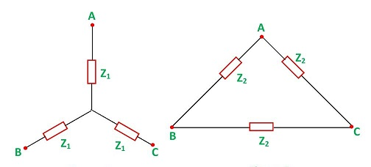
Applying the above conversion formulas (star to delta vice-versa), let equivalent star impedance Z1 and delta is Z2.
The delta impedance in terms of star impedances is given
The star impedance in terms of delta impedances is given

Slide 55
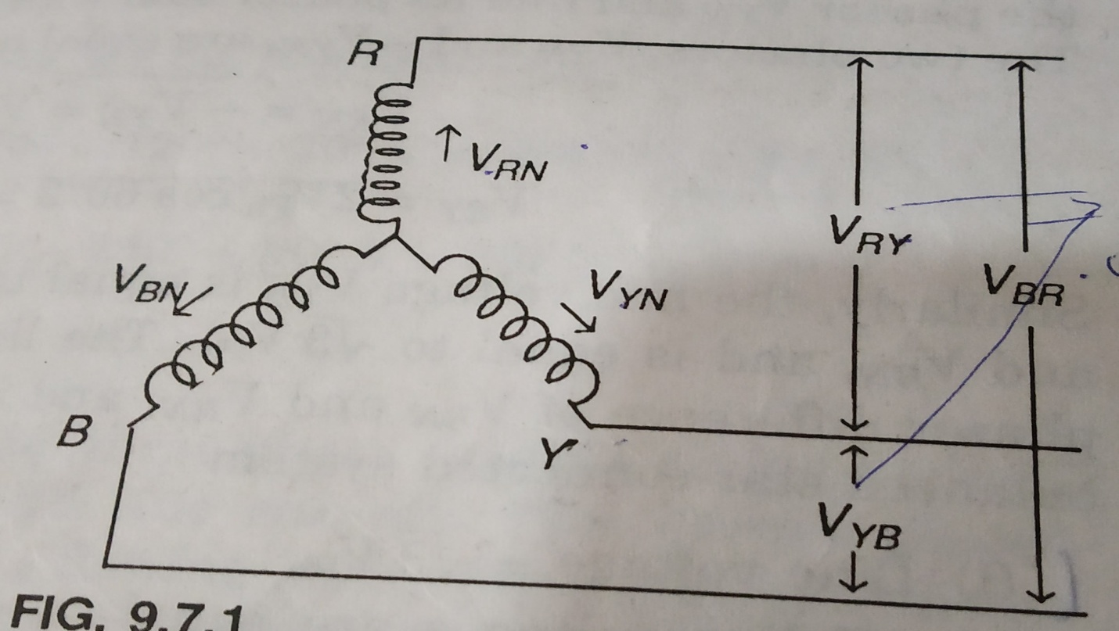
Voltage, Current and Power in a Star Connected Balanced System
The above figure shows a balanced three phase star connected system. The voltage induced in each winding called phase voltage (Vph).

Slide 56
The voltage available between any pair of terminals is called the line voltage . are line voltages.
indicates the voltage between point R and Y, with R being positive with respect to point Y during positive half cycle. Similarly in , the Y is positive w.r.to B during positive half cycle.
It also write as
Voltage Relation: the phasors corresponding to the phase voltages constituting a three phase system can be represented by a phasors diagram as shown below.

Slide 57
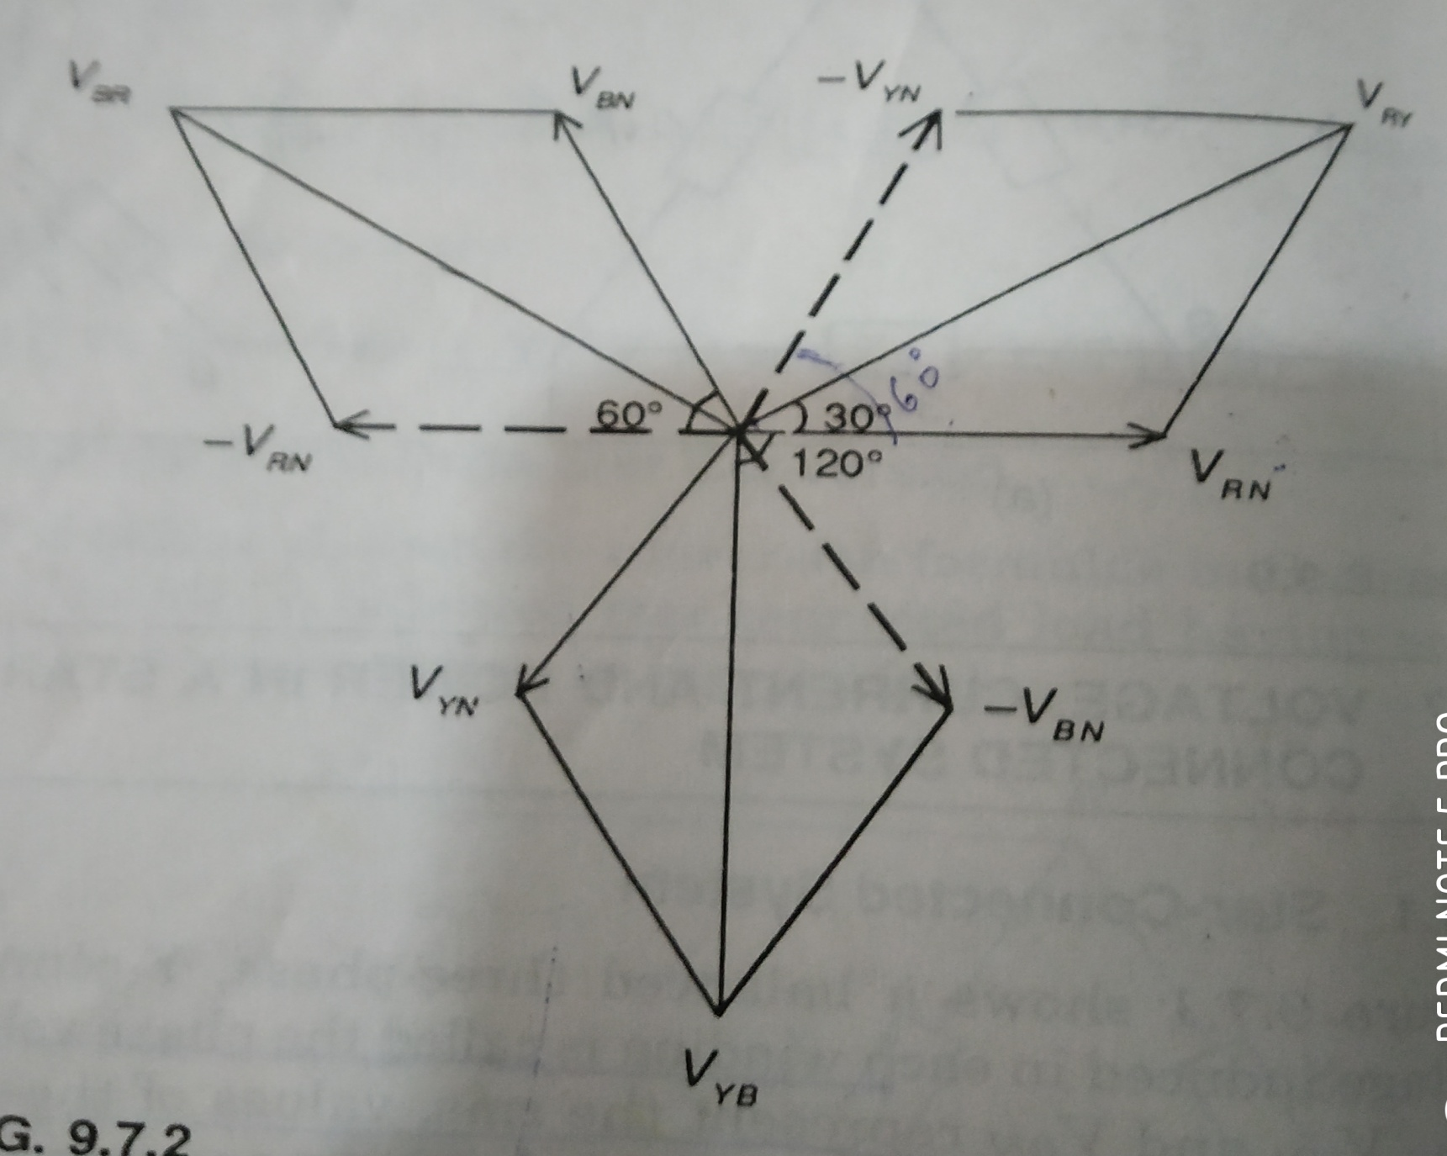
The is equals to the phasor sum of and , these two phasors are equal in magnitude and are 60 degrees apart.

Slide 58
Similarly, the line voltage is equal to the phasors sum of
and and is equal to . Hence, in a balanced star connected system
Line voltage =
All line voltages are equal in magnitude and are displaced by 120 digress and
All line voltages are 30 degree ahead of their respective phase voltages.

Slide 59
Problem 10: A symmetrical star connected system. The phase voltage , calculate the line voltages assuming RYB phase sequence.
Current Relation in star connected system: the phase and line currents of star connected system are shown below

Slide 60
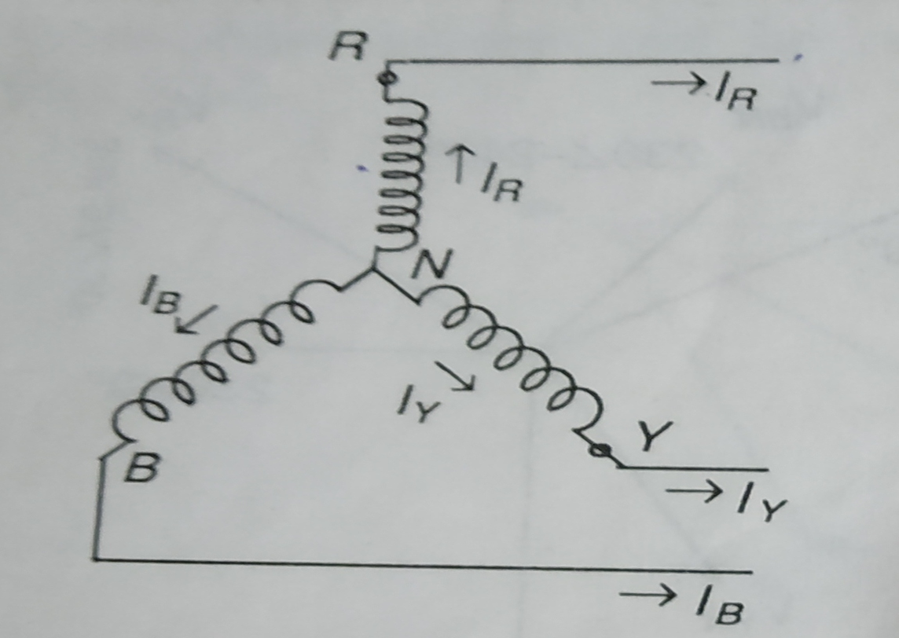
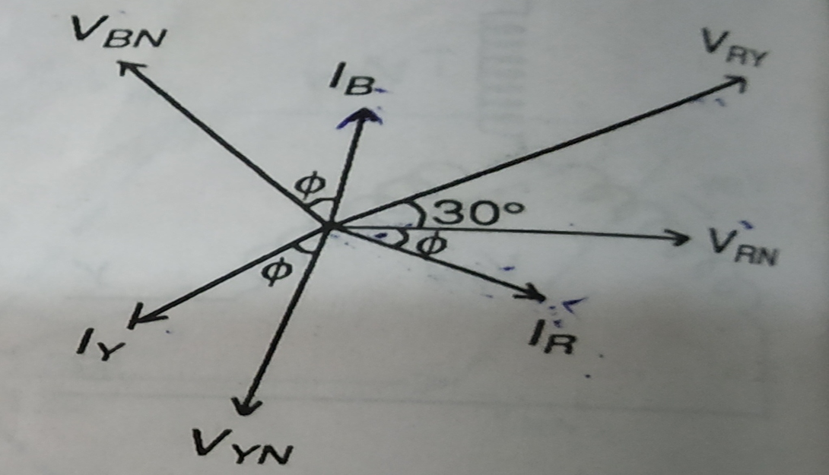

Slide 61
The phasors diagram shows all the phase current w.r.to their phase voltages. All the phase currents are displaced by 120 degrees w.r.to each other and digress lagging w.r.to their phase voltages.
From the figure, each line conductor is connected in series with its individual phase windings. Therefor, the current in a line conductor is same as that in the phase, it means the line currents are equals to phase currents.
The angle between the line (phase) current and corresponding to line voltage is (30+ ) for lagging load.

Slide 62
Power in the star connected network: the total active power or true power in the three phase load is sum of powers in the three phases.
For the balanced load, the power in each load is the same, hence total power=3 X power in each phase.
The three phase power generally express in terms of line quantities as follows

Slide 63
Problem 11: A balanced star connected system, the phase voltage and current are
. Calculate the line voltages and line currents, when phase sequence is RYB.
Problem 12: A balanced star connected load of
Per phase is connected to a balanced 3-phase 400V supply.
The phase current is 12A, determine the active power and power factor.

Slide 64
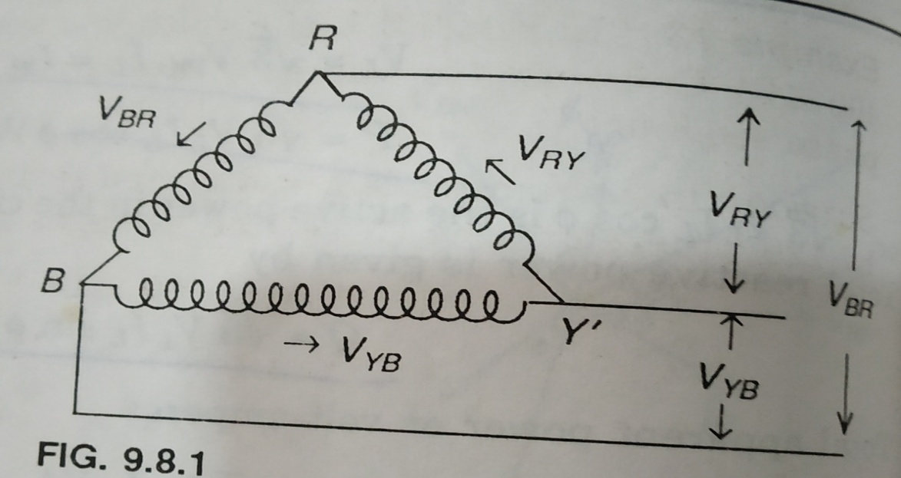
Voltage, Current and Power in a Delta Connected Balanced System
The above figure shows a balanced three phase delta connected system. This arrangement is referred to as mesh connection because it forms a closed circuit.

Slide 65
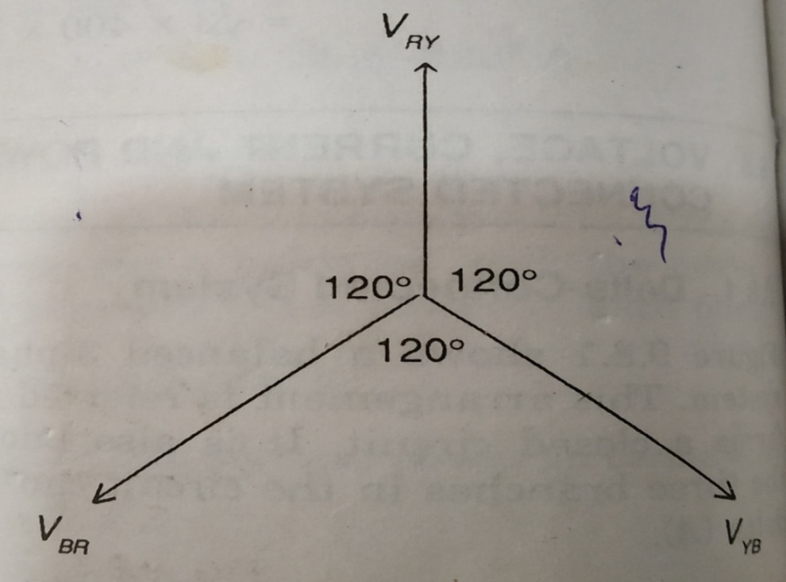
Since the system is balanced, the sum of the three voltages around the closed mesh is zero; consequently, no current can flow around the mesh when the terminals are open.
Voltage Relation: the line voltages are displaced by 120 degrees as shown below

Slide 66
From the above figure, only one phase is connected between any two lines. Hence , the voltage between any two lines is equal to the phase voltage .
Current Relation: Since system is balanced, three phase currents , i.e. are equal in magnitude but displaced by 120 degrees from one another.
Let are the line currents , all the line currents are directed outwards, at no instant will all the three line currents flow in the same direction.

Slide 67
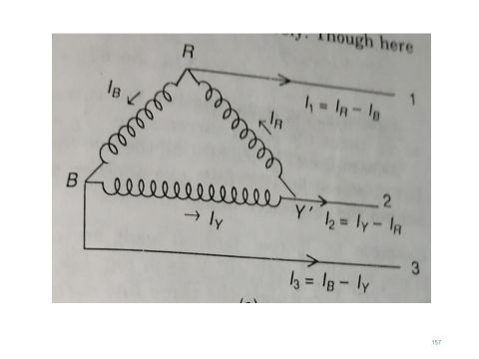
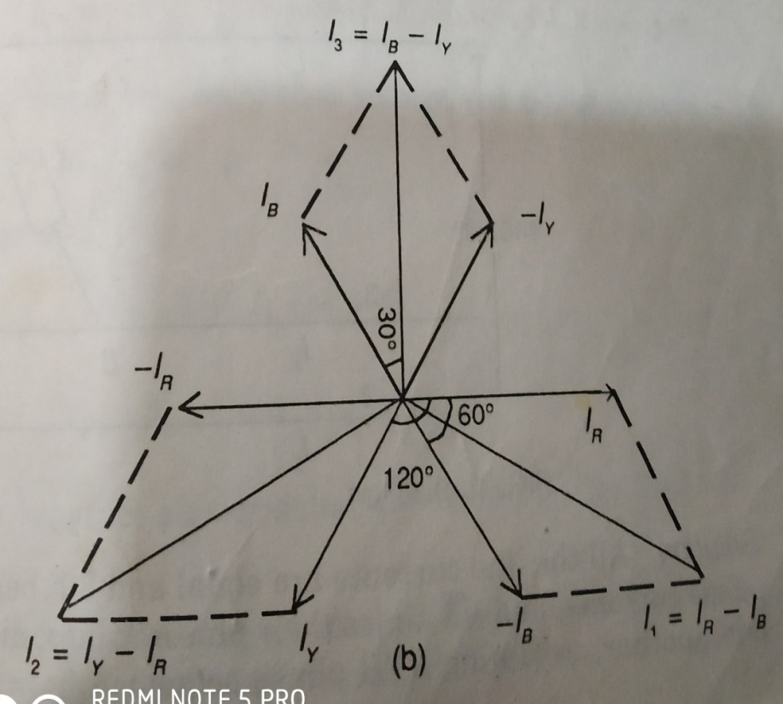
The relation between phase and line currents in delta system are shown in phasors diagrams

Slide 68
Determine the line currents in above figures by applying KCL at the three terminals R,Y, and B respectively.
Thus, the current in the line 1, ; i.e. the current in any line is equal to the phasors difference of the currents in the two phases attached to that line.
Similarly, the current in the line 2, and the current in the line 3, .
The phasors addition of line currents are
since

Slide 69
Similarly, remaining two line currents, are also equals to , i.e the line current .
All the line currents are equal in magnitude but displaced by 120 degrees from one another. The line currents are 30 degrees behind the respective phase currents.
Problem 13: Three identical loads are connected in delta to a three phase supply of V. If the phase current is 25 A, calculate the three line currents.

Slide 70
Power in the star connected network: Obviously the total active power or true power in the delta circuit is the sum of the powers in the three phase.
Since the load is balanced, the power consumed in each phase is same. Total power equals to 3 times the power in each phase.
The three phase power generally express in terms of line quantities as follows

Slide 71
Problem 12: A balanced delta connected load of
per phase is connected to a balanced three supply is . Determine the phase currents, line voltages and power drawn by the load.

